Slide 1
Facilitating Online Learning ToT
Pilot Cohort!
November 2020

Slide 2
A WARM WELCOME
As we begin, please rename what you would like people to call you for this workshop time – it will be recorded and available privately on the DAI Institute
BEGIN RECORDING
Icebreaker & Introductions
on Menti.com

Slide 3
OVERVIEW OF OUR TIME TOGETHER
DAY 1 LEARNING OUTCOMES:
Define key terms for online learning
Identify how Zoom time is precious
Describe top factors for making a workshop transformative/effective (Jamboard)
Introduce tools to engage participants: Jamboard, Menti, Zoom, and Flip Grid
Overview our Facilitation Practice #1 and #2
DAY 2 LEARNING OUTCOMES:
Utilize new tools and the DAI Institute to facilitate learning virtually
Facilitation Practice #1: Teach a short mini lesson in small groups and receive feedback
Understand the importance of observing other facilitators to grow in your own practice
DAY 3 LEARNING OUTCOMES:
Facilitation Practice #2: Teach a short mini lesson in small groups and receive feedback
Self-reflect on new and inspiring ideas, any anticipated challenges, and set a goal
Closure, question and answer time
Graduation with certificates and photo

Slide 4
ONLINE LEARNING DEFINITIONS
ASYNCHRONOUS: not at the same time, participants learn at their own pace
SYNCHRONOUS: learning at the same time
VIRTUAL/ONLINE
IN-PERSON/FACE TO FACE
BLENDED LEARNING: combines virtual and in-person
FLIPPED CLASSROOM: Prior to class, participants complete assignments, readings, or watch recorded lectures. During class, participants interact with one another to apply key concepts, collaborate, and discuss

Slide 5
ZOOM TIME IS PRECIOUS TIME
Time is limited - every second matters.
Priority during “live” Zoom time is to facilitate active interaction. NO LONG LECTURES.
Ask yourself:
Asynchronous: What can participants complete on their own before or after our live zoom time?
Synchronous: What are interactive activities or discussion questions that will maximize our learning while we are together?

Slide 6
SMALL GROUP DISCUSSION
We are going to use Jamboard to share our thoughts. This is a virtual substitute to sticky notes on chart paper.
TOPIC: Leading Transformative Workshops
What are the top factors that make a workshop transformative or effective? Think about your own experience attending or facilitating.
Head to our Jamboard:

Slide 7
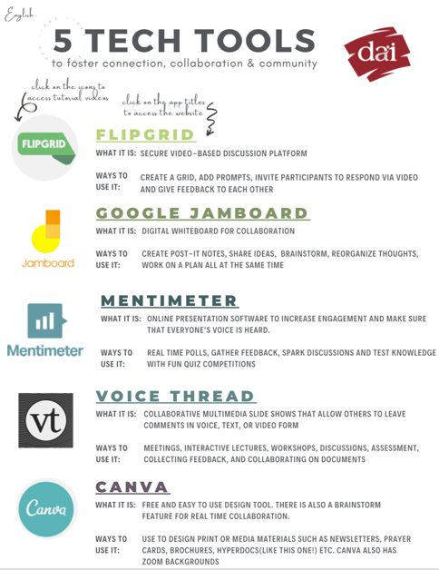
BEHIND THE SCENES: TECH TOOLS
Let’s take a peek at the Tech Tools we used:
Jamboard: How to create and share the link
Zoom: Screenshare and breakout rooms
TUTORIAL VIDEOS:
Click here for a Zoom Tutorial Video on Breakout Rooms
Click here for how to create a Jamboard
Click here for How to share a Jamboard
You can also access tutorial videos through the 5 Tech Tools Hypderdoc on our Cohort page

Slide 8
FACILITATION PRACTICE #1 & #2
Learn by DOING
You will have TWO opportunities to practice facilitating in small groups.
Practice #1: Building a sense of community
Practice #2: Engaging Facilitation
Utilize a checklist to prepare and reflect
Share MS Word file in Zoom chat
It will also be available on the cohort page

Slide 9
FACILITATORS ARE THE KEY
Tools are tools, but what makes a workshop transformative is the interaction between the facilitator and the participants.
So whether you’re face-to-face using a microphone, a projector, tables and chairs, or virtual on Zoom, FlipGrid or Menti, the most important aspect is connecting with your participants to guide and lead the learning.

Slide 10
TECH TOOL: FLIP GRID
Asynchronous video discussion tool
Secure
Used all over the world from kindergarten-PhD scholars at prestigious universities
Facilitators pose questions and participants respond with a short video. Others can respond with text or video.
Click above or type in
JOIN CODE: f823173b

Slide 11
HOMEWORK [for Wednesday December 9]
Prepare for Facilitation Practice #1
Respond to the question on Flipgrid
Add a comment to two or more responses
*All of these resources can be found on the FOL Cohort Page:
https://institute.daintl.org/fol_01

Slide 12
WRAP UP AND QUESTIONS
Before we dismiss, what questions do you have?
Group Reflection in chat box:
* NEW
! IMPORTANT
God bless you and see you for session 2!

